Slide 1

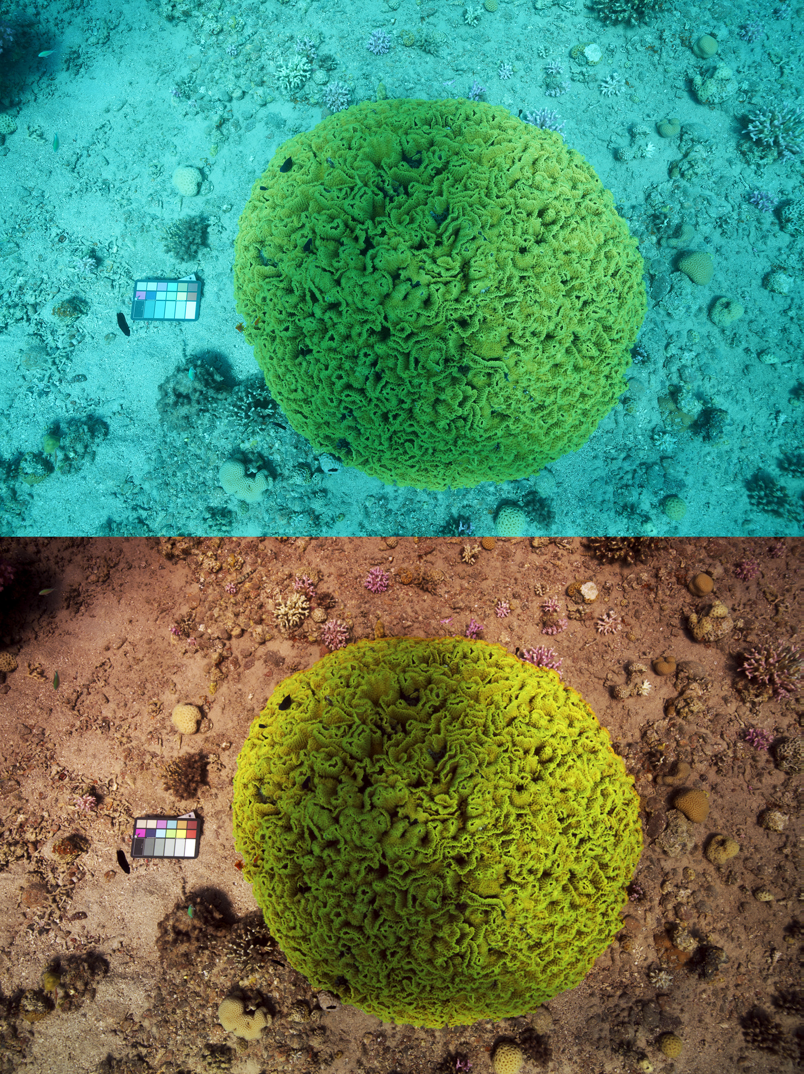
Midterm Presentation Color restoration of underwater images
Students: Ofer Hazut, Amir Saad
Supervisor: Tali Treibitz PhD
Context: Project B
Semester: Spring, 2019
Date: Dec 2019

Slide 2
Presentation Outline
In this slide you put the general outline of the coming presentation

Slide 3
Project Goal
Recovering color of underwater images, exploring both parametric and non-parametric methods, based on the methods presented in an article by Akkaynak and Treibitz.

Slide 4
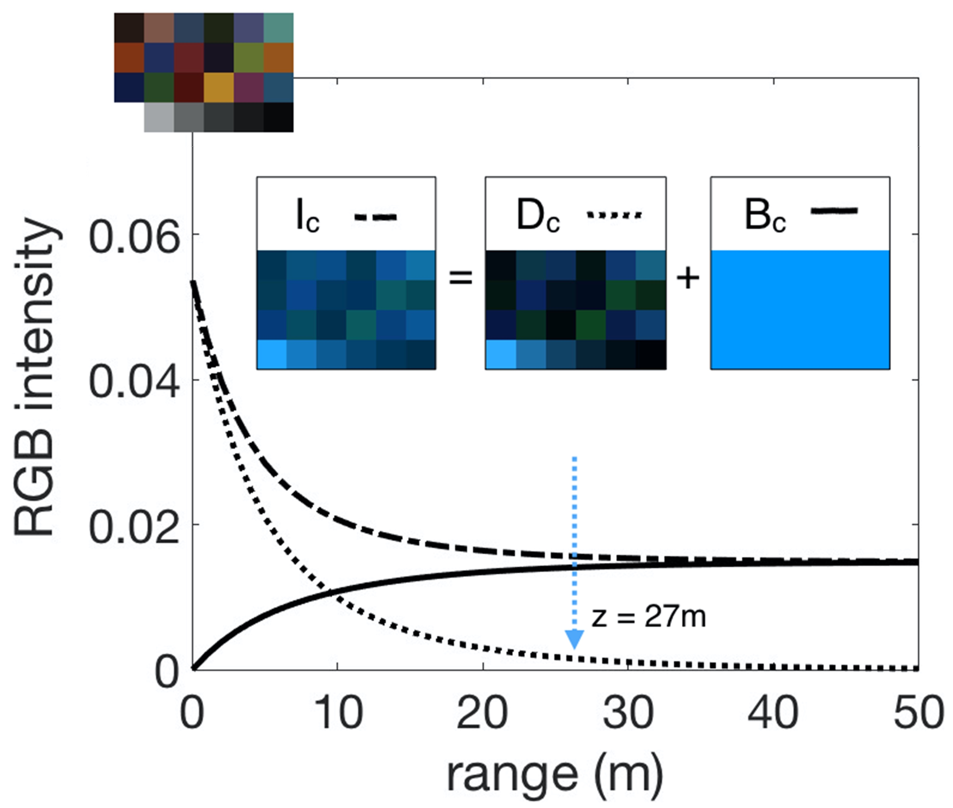

Background
Underwater images suffer from color degradation caused by attenuation and backscattering
$$I=D_{c}+B_{c}$$
No robust solutions
Notes:
נרחיב בהמשך – מדובר באות מונחת + בקסקטרינג – פיזור לא ישיר של האור בתווך

Slide 5
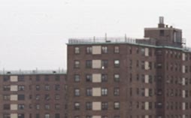

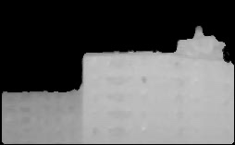
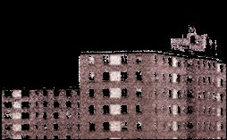
Optional Solutions
Model for bad weather (Nayar & Narasimhan)
No robust solutions:
Based on regular photographs (atmosphere) – good for short range in water.
Constant RGB Coefficients
Depth map is needed
(b)
(c) (d)
Clear day
Foggy day
Depth map
recovered

Slide 6
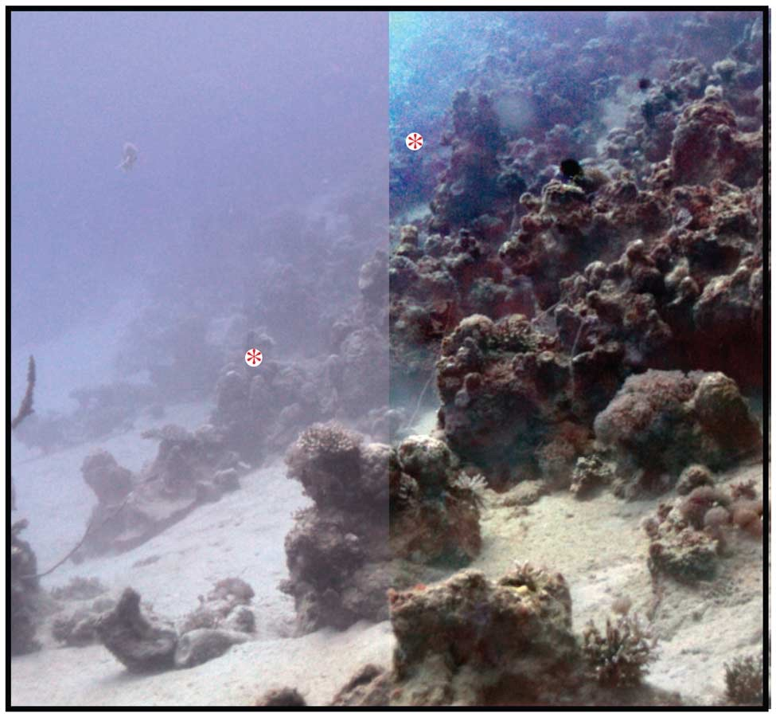
Optional Solutions
Model for underwater (Schechner & Karpel)
No robust solutions:
Additional information needed – 3D structure
Based on synthetic data
Constant Coefficients.

Slide 7
Optional Solutions
Dehazing
Based on synthetic data

Slide 8
Optional Solutions
No robust solutions:
Based on regular photographs (atmosphere) – good for short range in water.
Model for bad weather (Nayar & Narasimhan)
Unstable, too sensitive.
Additional information needed – 3D structure
Coeffs not based on wavelength/depth
Based on synthetic data

Slide 9
Chosen solution: Block Diagram
A detailed explanation about the chosen solution – a block diagram is a very good way to start with, probably followed with a few more slides describing the solution and maybe more diagrams for details if needed

Slide 10
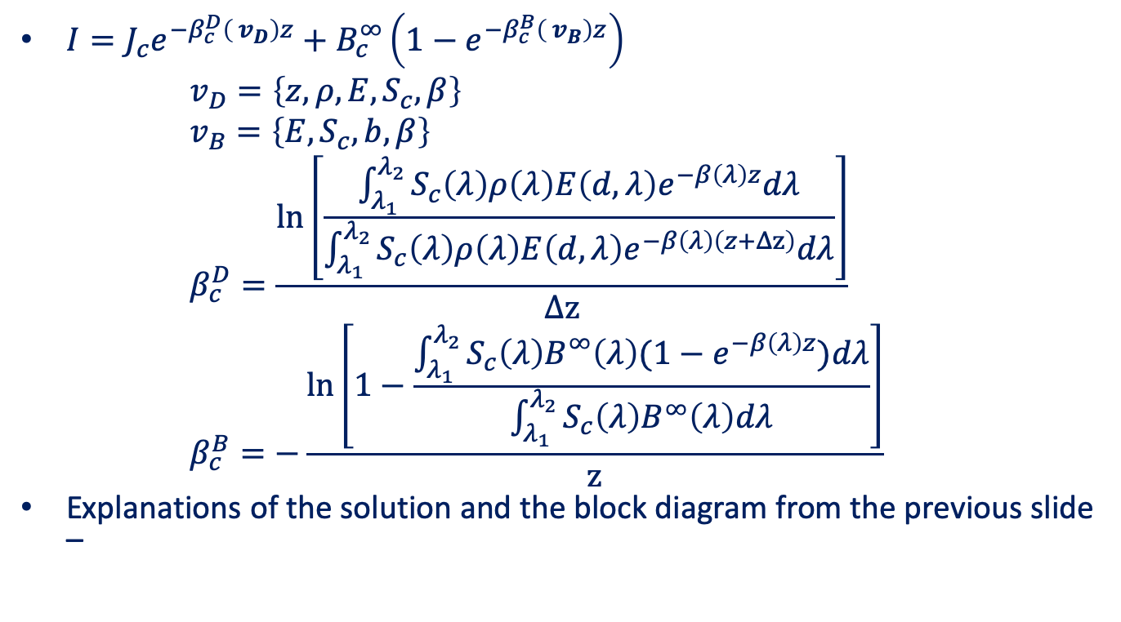
Chosen solution: details
$I=J_{c}e^{−β_{c}^{D}\left( v_{D}\right)z}+B_{c}^{∞}\left(1−e^{−β_{c}^{B}\left( v_{B}\right)z}\right)$ $v_{D}=\left\{z,ρ,E,S_{c},β\right\}$ $v_{B}=\left\{E,S_{c},b,β\right\}$ $β_{c}^{D}=\frac{\ln\left[\frac{\int_{λ_{1}}^{λ_{2}}{S_{c}\left(λ\right)ρ\left(λ\right)E\left(d,λ\right)e^{−β\left(λ\right)z}dλ}}{\int_{λ_{1}}^{λ_{2}}{S_{c}\left(λ\right)ρ\left(λ\right)E\left(d,λ\right)e^{−β\left(λ\right)\left(z+Δz\right)}dλ}}\right]}{Δz}$ $β_{c}^{B}=−\frac{\ln\left[1−\frac{\int_{λ_{1}}^{λ_{2}}{S_{c}\left(λ\right)B^{∞}\left(λ\right)(1−e^{−β\left(λ\right)z})dλ}}{\int_{λ_{1}}^{λ_{2}}{S_{c}\left(λ\right)B^{∞}\left(λ\right)dλ}}\right]}{z}$
Explanations of the solution and the block diagram from the previous slide –

Slide 11
Results
Present your results – the output of your system with comparison to other systems so you can show what you do better than others

Slide 12
Summary
A short summary of the work – main points in the implementation , achievements, original contribution etc.

Slide 13
Conclusions
Explain in short what can be learned from your results, future work you think can be done etc.

Slide 14
References
Only most important references should be mentioned here, in the following form:
[#] Author name(s), Title, Publisher (conference/Magazine) , Year

